Slide 1
IMMUNE SYSTEM

Slide 2
Immune system
The word immune literally means free from burden
A collection of cells and proteins
Function to protect body from foreign antigens (microbes, cancer cells, and toxins).
Immunology is study of specific immunity and how immune system responds to specific infectious agents.
Two “lines of defense”
Innate immunity: 1st line of defense
Adaptive immunity: 2nd line defense

Slide 3
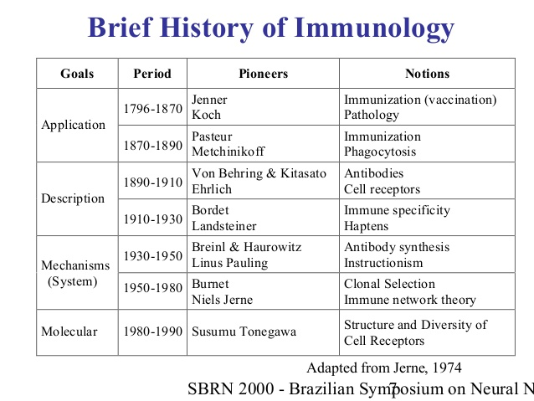
430 BC: Plague in Athens by Thucydides

Slide 4
Innate Vs Adaptive
Innate
Non-specific to invading pathogen (Ag)
Rapidly mobilized at initial site of infection
Lacks immunologic memory
Effective and critical in eliminating most pathogens
Phagocytes and NK cell
Adaptive
Antigen-dependent and antigen-specific
Confer protective immunity to reinfection
Capacity for memory
Lymphocytes carrying cellular receptors and specific antibodies

Slide 5
Factors influencing Innate immunity
Age
Immature immune system in very young children and
waning immunity in older individuals
Nutritional status: immunities are lowered in malnutrition
Hormonal levels: hormonal disorders increasingly susceptible to infection.
Pregnant women: higher level of steroid

Slide 6
Mechanisms of innate immunity
Function of innate immunity;
It kills invading microbes and
It activates acquired (adaptive) immune processes
Primarily dependent on four types of defensive barriers:
(a) Anatomic barriers
(b) Physiologic barriers
(c) Phagocytosis, and
(d) Inflammatory responses

Slide 7
A. Anatomic barriers/mechanical barriers
Skin and mucous membrane.
Sweat and sebaceous: Antimicrobial properties
Saliva, tears, and mucous secretions tend to wash away potential invading mos.
Respiratory tract: Ciliated cells
Vagina: Lactobacilli and urethra (20 cm) in men
Urinary tract: Flushing action of urination

Slide 8
B. Physiologic barriers
Gastric acidity: low pH of stomach (0.2% hydrochloric acid )
Soluble mediators of innate immunity;
Lysozyme
Interferon
Complement

Slide 9
C. Phagocytosis
The process whereby a phagocytic cell (blood monocytes, neutrophils, and tissue macrophages)
Recognizes pathogen
Ingests it, and then
Destroys engulfed organism
A type of endocytosis in which invading microbes are ingested by phagocytic cells
Plasma membrane of cell expands around particulate material (mos.) to form large vesicles called phagosomes.

Slide 10
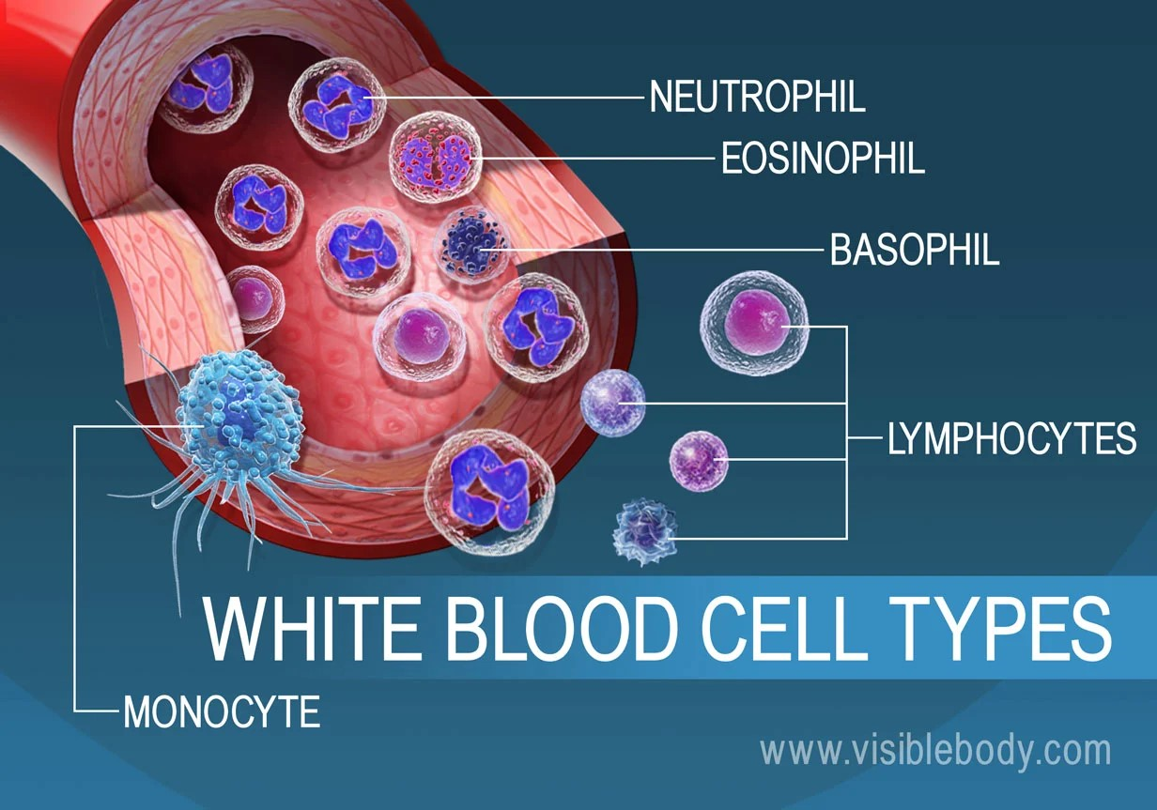
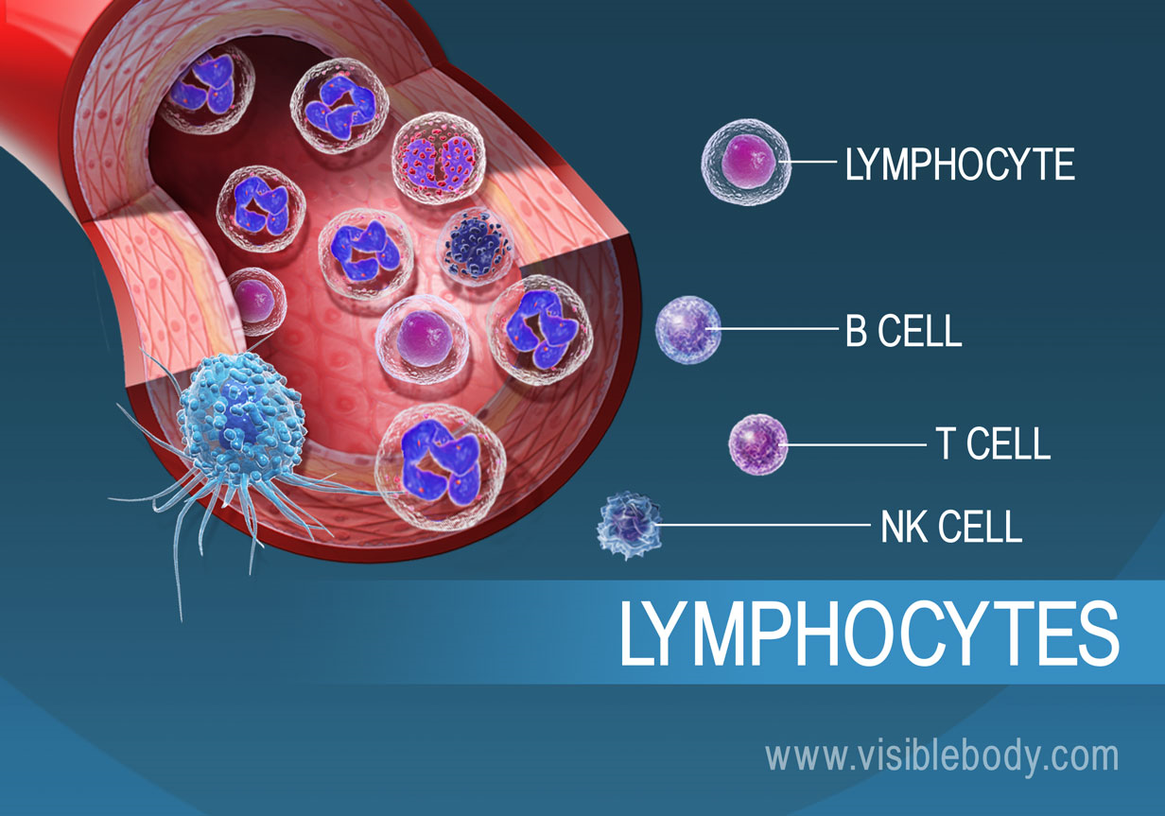
The main functions of phagocytic cells include:
Chemotaxis, Migration, Ingestion, and microbial killing.
Phagocytes in immune system consist of:
(1) Monocytes and macrophages;
(2) Granulocytes (PMNs, eosinophils and basophils) and
(3) Dendritic cells.
Fig. 1 WBC types
Notes:
WBC, White blood cells; PMNs, Polymorph nuclear neutrophils

Slide 11
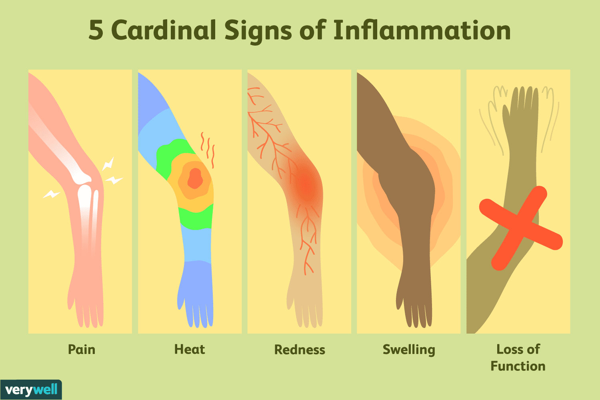
D. Inflammatory responses
Tissue damage caused by a wound or by an invading pathogenic mos. induces a complex sequence of events
The end result:
Activation of immune response or
Clearance of invader
The 5 cardinal features of inflammatory responses;
Rubor (redness),
Calor (rise in temperature),
Dolor (pain), and
Tumor (swelling)
functio laesa (loss of function)
Fig 2. cardinal features of inflammatory responses

Slide 12
Goals of inflammatory response:
Prevent initial establishment of infection or remove damaged tissue.
Prevent spread of infection or repair damaged tissue.
Recruit effector cells if immune cells of innate immune system cannot control infection or repair damaged tissue.
Mobilize effector cells (T and B lymphocytes)

Slide 13
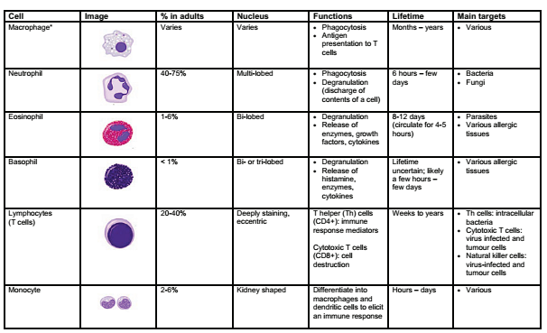
Table 2: Characteristics and function of cells involved in innate immunity

Slide 14
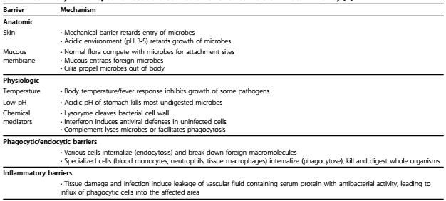
Table 3: Summary of non-specific host-defense MOA for barriers of innate immunity

Slide 15
2. Adaptive immunity
Develops when innate immunity is ineffective and infection is established.
The recognition of specific “non-self” antigens in presence of “self” antigens
Generation of pathogen-specific immunologic effector
Development of an immunologic memory
Cells include:
T cells: activated through action of antigen presenting cells (APCs), and
B cells

Slide 16
Antigens
Substance provoke production of an Abs.
“Antibody generator.”
Immunogens are molecules that induce an immune response.
Antigens are immunogens.
Ags that are not immunogenic but can take part in immune reactions are termed as Haptens.
Immunogenicity means ability of an Ag to elicit an immune reaction in form of a B or T-cell response.
Notes:
Abs, Antibodies; Ag, Antigen

Slide 17
Determinants of Antigenicity
A number of factors have been identified that make a substance immunogenic, include:
Foreignness: Recognized as “non-self.”
ability of host to tolerate self antigens.
2. Size: large molecular weight are highly antigenic.
Certain small molecules (e.g, haptens) become immunogenic only when linked to a carrier protein

Slide 18
Cont.
3. Chemical and structural complexity
Proteins are most potent immunogens followed by polysaccharides.
4. Stability
Highly stable and non-degradable substances (e.g., some plastics, metals, or chains of D-amino acids) are not immunogenic
5. Genetic constitution of host
6. Dosage, route, and timing of antigen administration
booster doses: Repeated administration of antigens
Parenteral route/subcutaneous route

Slide 19
Adjuvants
It enhance immunogenicity of a substance
Stimulate immune response by facilitating uptake into APCs.
Increase both strength and duration of immune response
Adjuvants boost immunogenicity of antigens in several ways:
Aluminum potassium sulfate (alum) and
Freund’s water-in-oil
Notes:
APC, antigen presenting cell

Slide 20
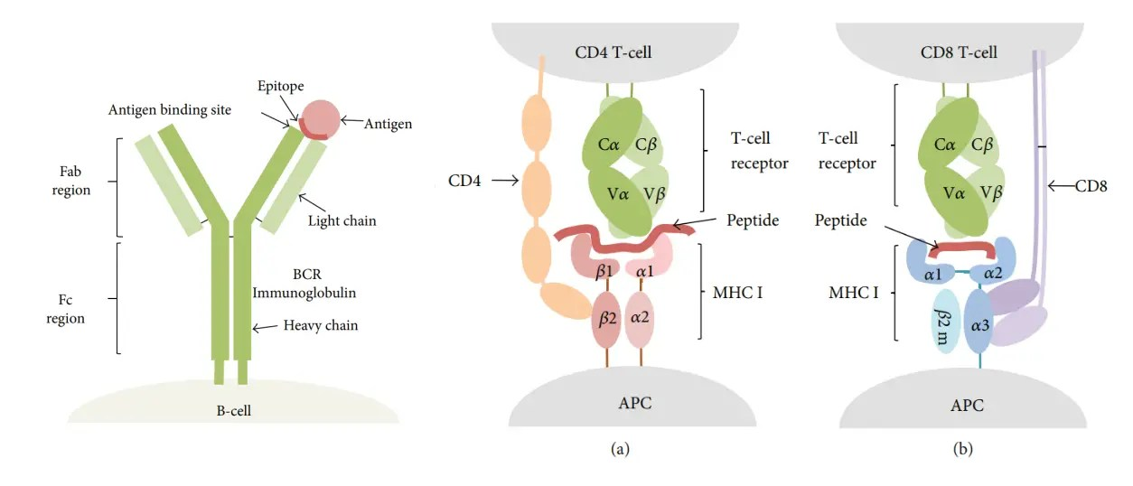
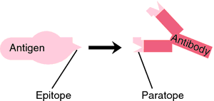
Antigenic Specificity
Antigenic specificity of Ag depends on antigenic determinants or epitopes.
An epitope is defined as immunologically active region of an immunogen that binds to Ag-specific membrane receptors on lymphocytes or secreted antibodies.
There are two types of epitopes:
B-cell epitopes and
T-cell epitopes
Fig. 4 B-cell (left) and T-cell (right) epitope recognition
Notes:
Ag, Antigen

Slide 21
T cells and APCs
T cells derive from HSCs in BM and, following migration, mature in thymus.
These cells express a unique antigen-binding receptor on their membrane (TCR)
TCR: require action of APCs to recognize a specific antigen.
The surfaces of APCs express cell-surface proteins known as major histocompatibility complex (MHC).
MHC protein: displays fragments of antigens (peptides) when a cell is infected or has phagocytosed foreign proteins
Notes:
bone marrow (BM), hematopoietic stem cells (HSC), APCs

Slide 22
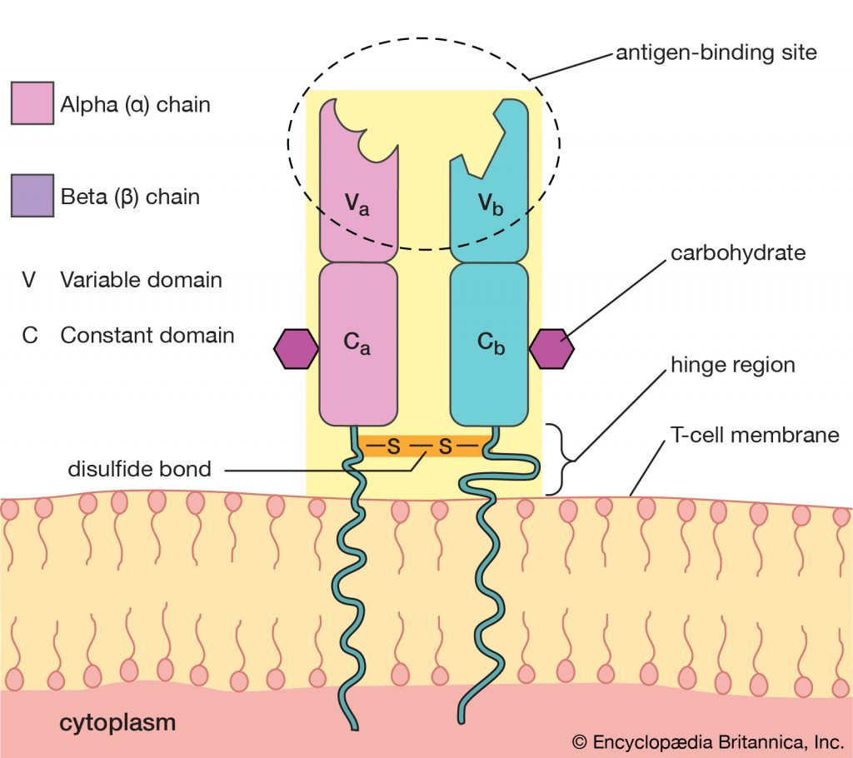
Fig. 5 Structure of T-Cell

Slide 23
MHC classified as:
Class I (HLA: A, B and C)
Found on all nucleated cells
Present endogenous (intracellular) peptides
Presentation of peptide antigens to TC cells
Class II (HLA: DP, DQ and DR)
Found on only certain cells of immune system (APCs)
Present exogenous (extracellular) peptides
Present processed antigenic peptides to TH cells
Notes:
human leukocyte antigen [HLA]

Slide 24
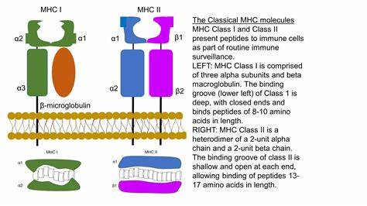
Extracellular fluid
All nucleated cell
APC
cytoplasm
Fig. 6 Structure of MHC
Notes:
APC, Antigen presenting cell (Macrophage, Dendritic cell and B-Cell)

Slide 25
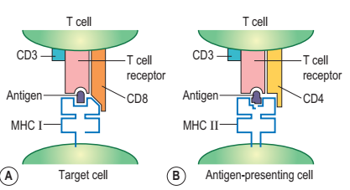
T cells are activated when they encounter an APC that has digested an antigen and is displaying antigen fragments bound to its MHC molecules.
The MHC-antigen complex activates TCR and T cell secretes cytokines which further control immune response.
This antigen presentation process stimulates T cells to differentiate into either cytotoxic T cells (CD8+ cells) or T-helper (Th) cells (CD4+ cells)

Slide 26
Processing of an Ag by APCs is absolutely essential for a T cell to recognize it.
Two different types of processing can prepare a protein Ag for Ag presentation.
These include:
Externally derived antigens’ processing: class II MHC molecules and are recognized by CD4- positive helper T cells.
Endogenously derived antigens’ processing: virus proteins synthesized in a cell present to class I MHC molecules and recognized by CD8-positive cytotoxic T lymphocytes
Notes:
Ag, Antigen; APC, Antigen presenting cell

Slide 27
Cont.
The common is that T lymphocyte recognize, through their:
TCR complex (CD3, CD4 or CD8, TCR), Ag fragments in association with MHC molecules.
CD4+ cells produce molecules, lymphokines, that stimulate and support production of immune system cells.
CD8+ cells are involved in destruction of virally infected cells and the destruction of tissue grafts from MHC incompatible donors.
Fig. Molecules involved in T cell recognition.

Slide 28
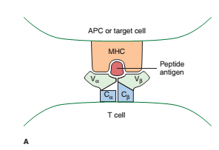
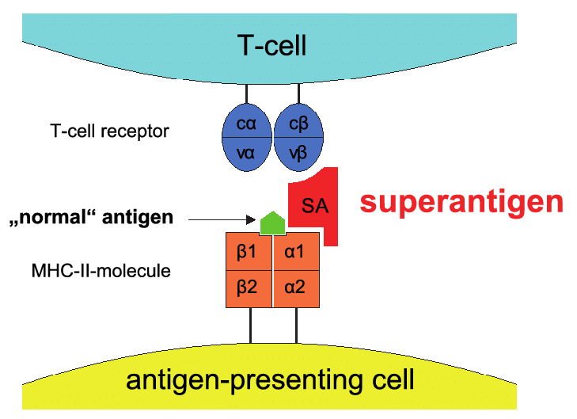
Cont.
Some super-antigens are able to bind to MHC molecules outside the peptide-binding cleft
Fig. Binding of antigen by MHC and T-cell receptor.
In panel A, V α and V β regions of the TCR are shown interacting with the α helices that form the peptide-binding groove of MHC.
In panel B: The super-antigen interacts with the V β region of the TCR and with class II MHC outside the peptide-binding groove.

Slide 29
Antibody-mediated (AMI) vs. cell-mediated immunity (CMI)
Antibody-mediated (AMI): mediated by B-cell antibody production.
The secreted antibodies bind to antigens on surface of pathogens, flagging them for
Destruction through pathogen and toxin neutralization
Classical complement activation
Opsonin promotion of phagocytosis and
Pathogen elimination.

Slide 30
CMI
Directed primarily at microbes that survive in phagocytes and infect non-phagocytic cells
Most effective in eliminating virus-infected cells
Plays a major role in transplant rejection.

Slide 31
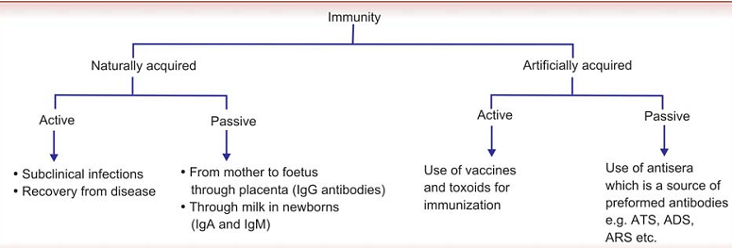
Passive vs. active immunization
Notes:
Tetanus antitoxin (ATS), Gas gangrene antitoxin (AGS), Diphtheria antitoxin (ADS), Antirabies serum (ARS), Antisnake venom polyvalent

Slide 32
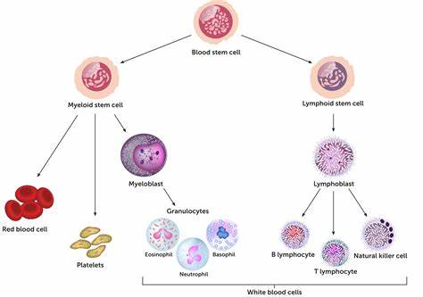
IMMUNE SYSTEM
Immune system consist of
Cellular components
Molecular components
Cellular components
blood stem cell
Myeloid stem cell
Lymphoid stem cell
Myeloblast
Red blood cell
B cell
Platelet
T cell
NK cell

Slide 33
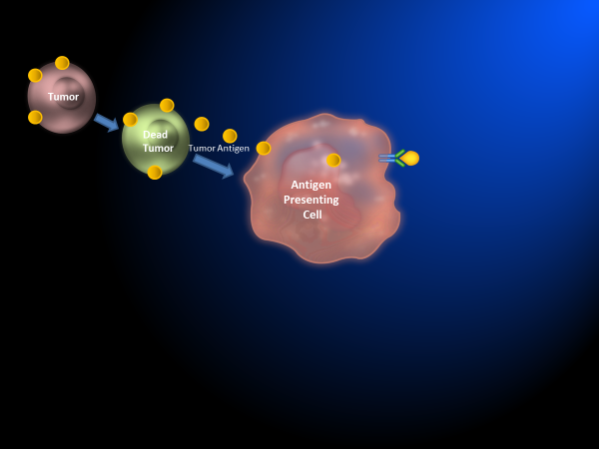
A. Cellular components
1. Antigen-presenting cell (APCs)
Dendritic cells: skin, lymph node and other tissues.
Sentinel APCs
Taking up antigen
Activate T-cells
Monocytes: Circulating in Blood
Macrophages: tissue (long-lived cells)
B-cells: develop in to plasma cells, manufacture and secret antibodies
Alveolar macrophages in lung
Histiocytes in connective tissues
Kupffer cells in the liver
Mesangial cells in the kidney
Microglial cells in the brain
Osteoclasts in bone
Fig. Tumor Antigens Presented on APC( Asim Amin)
Notes:
Macrophages, Dendritic cells: APC+Phagocytosis

Slide 34
2. Lymphocytes
2 main types of lymphocytes
B-cells: mature in bone marrow
T-cells: mature in thymus
-cooperate with B cells and produce cytokines
Functions of T Cells
CMI through production of cytokines
Act on and destroy virus infected cells, tumour and foreign cells (cytotoxic action)
Act as regulatory cells: help or suppression
Notes:
cell-mediated immunity (

Slide 35
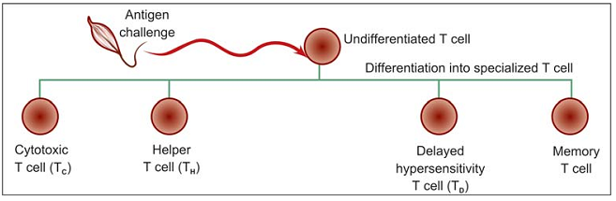
T Cell Subsets and their Functions
Three major functional subsets
Helper T cells (CD4 Cells):help B cells and other T cells to multiply into large clones
Cytotoxic T cells (CD8 Cells): killing virus-infected cells, transplant tissue, and cancer cells by secreting a series of molecules known as lymphotoxins (LT)
Delayed type hypersensitivity T cells: DTH
Fig. Subsets of T cells

Slide 36
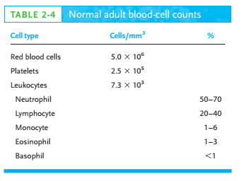
Mast cells
similar to basophils (development of allergies): Histamine
Natural killer (NK) cells: Innate lymphoid cells (5 to 15%)
Tumor surveillance and some virus
Antibody-dependent cell-mediated cytotoxicity (ADCC)
Polymorph-nuclear Leukocytes (PMNs)
Neutrophils (50–70%): Phagocytic
First to arrive at a site of inflammation
short-lived cells
Eosinophils (1–3%):Phagocytic
Defense against parasitic organisms
Basophils (<1%): Non-Phagocytic
Role in certain allergic responses)
High affinity to IgE

Slide 37
B. Molecular components
1. Acute phase reactant: Liver plasma proteins whose level dramatically or due to IL-1 and IL-6 in infection or tissue damage
CRP
Serum amyloid A
Mannose-binding lectin

Slide 38
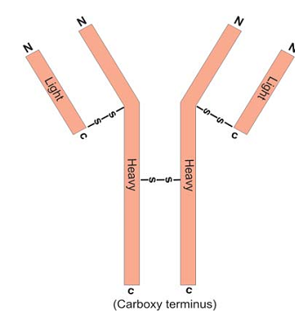
2. Antibodies
Blood proteins (humoral antibodies)
Globulins (Igs) part of gamma fraction of serum
Structure
Igs: molecules are symmetrical structures
‘Y’-shaped after binding to an antigen
Each molecule consists of four polypeptide chains:
Two identical heavy (H) chains and
Two identical light (L) chains
L-chain to H-chain by disulphide bond
H-distinct for each class of Igs
L-Similar in all classes of Ig (Kappa (κ) and lambda (λ).
Fig. Antibody molecule
Notes:
Immunoglobulins (Ig)

Slide 39
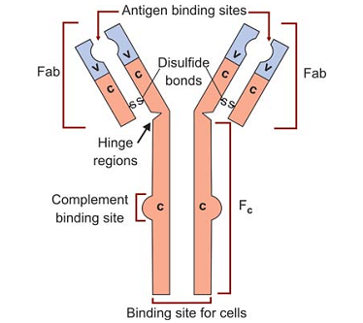
L and H chains are subdivided into variable regions and constant regions.
An L-chain consists of one variable domain (VL) and one constant domain (CL).
Most H-chains consist of one variable domain (VH) and 3 or more constant domains (CH).
Variable regions are responsible for antigen binding
Constant regions are responsible for biological functions
Antibody split by papain
Fab-fragment: antigen binding (2)
(paratope)
Fc-fragment: crystallizable (effector function of antibody)
Effector function (Fc)
Complement fixation
Binding to phagocytes & mast cell
Transplacental transfer
secretion into body fluids

Slide 40
Classes (Isotypes of Ig)
Based upon structure of heavy chain constant region
Five classes: IgG, IgA, IgM, IgD and IgE
H-chain designated by Greek letter as gamma (γ), alpha (α), mu (μ), delta (δ) and epsilon (ε) respectively
Class IgG *distinctive H-chains and differing functional properties* four subclasses: IgG1, IgG2, IgG3 and IgG4.
Similarly there are two subclasses each of IgA and IgM.

Slide 41
IgG:
Abundant in serum
Synthesized in secondary immune response
Major line of defense in a newborn (pass placenta and secreted in colostrum
Four isotypic subclasses - IgG1, IgG2, IgG3, and IgG4.
IgM
high M.wt (900,000)
A polymer of five four peptide units
Macroglobulin antibody
Primary immune response
IgA:
defend exposed external surfaces of body against attack by microbes
Found in secretion (tear, saliva, colostrum sweat)
Synthesized locally by plasma cells.
Two subclass IgA1 and IgA2.
IgD
present on surface of lymphocytes
control of lymphocyte activation and suppression
IgE
Con. in serum very low
Bound to mast cells
triggering an acute inflammatory reaction

Slide 42
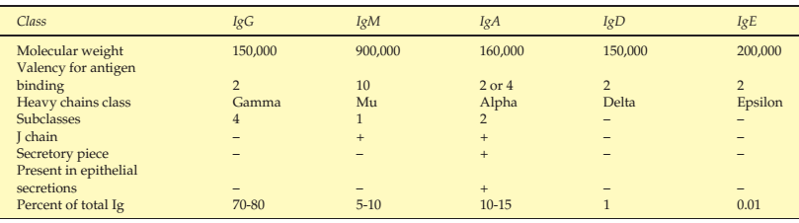
Characteristics of Immunoglobulins
Table. Characteristics of human Igs

Slide 43
Table: Summary of biological properties of human Igs
Function | IgA | IgD | IgE | IgG1 | IgG2 | IgG3 | IgG4 | IgM
Neutralize | ++ | − | − | + | + | + | + | +++
Complement fixation | ±a | − | − | ++ | + | +++ | − | +++
Binding to phagocytes | ±b | − | − | +++ | ± | +++ | + | −
Binding to mast cells | − | − | +++ | − | − | − | + | −
Enter tissues | − | − | − | + | + | + | + | −
Placental transfer | − | − | − | + | ± | + | + | −
Protects mucosal surfaces | + | − | − | − | − | − | − | −
Note: These activities are determined by the Fc portion of the molecules. a IgA activates alternative pathway. b Receptors for Fc portion of IgA have been found on neutrophils and alveolar macrophages.

Slide 44
3. Cytokines
Cytokines are potent, low-molecular weight protein cell regulators produced transiently and locally by numerous cell types.
Not antigen specific
Role in cell-to-cell communication
A key role in:
Hematopoiesis, Immunity, Infectious disease, tumorigenesis, Homeostasis, tissue repair, and cellular development and growth

Slide 45
Classification and Functions
Groups based on their common functions.
Immuno-regulatory: IFN- γ (antigen presentation)
Inhibition of viral replication
Proinflmmatory: IL-1, IL-6, TNF-α, and IFNs (in infectious diseases)
Anti-inflammatory: TGF- β, IL-10, IL-11, and IFN- β (dampen or downregulate an overactive inflammatory response) and
Growth and differentiation: colony stimulation factors (CSFs) and stem cell factor

Slide 46
Cont.
T cells use cytokines for differentiation into T-cell subsets.
Th 1 cells are generated in presence of IFN- γ
Th 2 cells are differentiated in the presence of IL-4.
Th7 cells are produced in presence of TGF- β and IL-6
Treg cells are formed in presence of TGF- β alone

Slide 47
Clinical Applications
At least four major clinical applications of cytokines.
Biomarkers of disease and provide clues for MOA of disease (TNF- α, IL-1, and IL-6 with septic shock-Proinflmmatory)
The measurement of cytokine production in vitro is a useful monitor of immune status (IFN- γ: T-cell function, TB reactivity)
Recombinant cytokines are key therapeutic agents (IFN- α for HCV, IFN- β for multiple sclerosis, and IFN- γ for CGD)
cytokines can be targets of therapeutics:
Inhibitors of TNF- α used to manage rheumatoid arthritis (RA) and
Inhibitors of IL-2 and IL-15 used in transplantation and cancer.

Slide 48
Complement system
Enzyme cascade that helps defend against infection
Includes serum (zymogens) and membrane bound proteins
Bridges innate and acquired immunity by;
Augmenting Ab responses and immunological memory
Lysing foreign cells
Clearing immune complex and apoptotic cells
Highly regulated and interact via a series of proteolytic cascades.

Slide 49
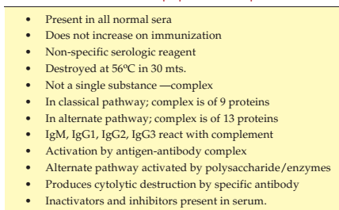
Table General properties of complement

Slide 50
Complement activations
3 Pathways of complement activations
1. Classical: labeled as “C” numbered from C1 to C9
Antibody dependent (Ag-IgM/Ag-IgG)
Antibody independent (polyanions/GNB/CRP) direct with C1
Reaction sequence is C1-C4-C2-C3-C5-C6-C7-C8-C9
2. Lectin: Ab-independent (MBL)
Serum protein bind Mannose/NAG
3. Alternative: Lettered (Factor B, D) or named (properdin)
microbial cell surfaces (yeast, LPS, Igs) cleave small amount of C3
All the 3 leads to membrane attack complex (MAC)

Slide 51
1. The Classical Pathway
C1, binds to Fc region of an Ig,
It is composed of three proteins, C1q, C1r, and C1s.
C1q is an aggregate of polypeptides that bind to Fc portion of IgG and IgM.
The Ab–Ag immune complex bound to C1 activates C1s
which cleaves C4 and C2 to form C4b2b.
The latter is an active C3 convertase, which cleaves C3 molecules into two fragments, C3a and C3b.

Slide 52
Cont.
C3a is an anaphylatoxin.
C3b forms a complex with C4b2b, producing a new enzyme, C5 convertase
which cleaves C5 to form C5a and C5b.
This leads to MAC and then to cell lysis.
Only IgM and IgG activate or fix complement via the classical pathway.
Only IgG subclass 1, 2, and 3 fix complement; IgG4 does not.

Slide 53
2. The Alternative Pathway
Infectious agents can activate complement system by triggering cellular production of factors B, D, and properdin.
These factors cleave C3 and generate C3 convertase.
C3 convertase (C3bBb) that was generated during the alternative pathway produces more C3b.
The additional C3b binds to the C3 convertase to form C3bBbC3b.
This enzyme is the alternative pathway C5 convertase that generates C5b
Leading to production of the MAC described earlier

Slide 54
3. Mannan-Binding Lectin (MBL) Pathway
Its main constituent is a plasma protein MBL.
MBL binds to sugar residues such as mannose found in microbial surface polysaccharides such as LPS.
The MBL complex, when bound to microbial surfaces, can activate C4 and C2.
The remaining steps in the pathway are the same as the classic pathway of complement activation.

Slide 55
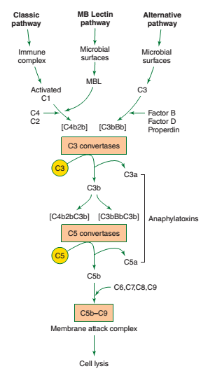
Recognition Unit: C1 (C1q, C1r, C1s)
Activation Complex: C4, C2, C3
Membrane Attack Complex: C5,C6, C7, C8, C9
Fig. Pathways of complement activation
Notes:
MAC, membrane attack complex

Slide 56
Biologic Effects of Complement
Activation of complement results in four major outcomes:
Cytolysis: Lysis of cells
Development of membrane attack complex (MAC) (C5b, 6, 7, 8, 9)
Inserts into membrane of an organism or cell.
MAC leads to loss of osmotic integrity and cell lysis
(2) Chemotaxis:
An immune cell (phagocyte) is attracted to and moves toward a soluble factor.
C5a is a potent chemotactic agent that stimulates movement of neutrophils and monocytes toward sites of antigen deposition

Slide 57
Cont.
(3) Opsonization:
A process in which mos. and Ag-Ab complexes become coated with molecules that bind to receptors on phagocytes.
Phagocytosis -C3b
(4) Anaphylatoxins:
Promote vasodilation and increased vascular permeability.
Both C3a and C5a are potent promoters
Stimulate mast cells and basophils to release histamine.
C5a is an anaphylatoxin as well as a chemotactic factor.
Notes:
Mos. microorganism

Slide 58
Complement Deficiencies and Pathogen Evasion
C2 : serious pyogenic bacterial infections
MAC: susceptibility to neisserial infections.
Alternative pathway (e.g, properdin): susceptibility to meningococcal disease).
C1 inhibitor protein leads to hereditary angioedema.

Slide 59
Immunopathology
Defects or malfunctions in either innate or adaptive immune response can provoke illness or disease.
Such disorders are generally caused by an:
Hypersensitivity reactions: overactive immune response
Autoimmunity: inappropriate reaction to self or
Immunodeficiency: ineffective immune responses

Slide 60
1. Hypersensitivity
An immune response results in exaggerated or inappropriate rxns that are harmful to host.
occur after second contact with a specific Ag (allergen).
The first contact is a necessary preliminary event that induces sensitization to that allergen.
There are four main types of hypersensitivity rxns.
Types I, II, and III are antibody mediated, and
Type IV is T-cell mediated.

Slide 61
1. Type I: Immediate Hypersensitivity (Allergy).
It manifests itself in tissue reactions occurring within seconds after
The Ag combines with the specific IgE Ab.
Its symptoms may manifest as:
A systemic anaphylaxis (eg, after IV administration of heterologous proteins) or
A local reaction (eg, an atopic allergy involving rhinitis such as occurs with hay fever).

Slide 62
Mechanism of immediate hypersensitivity
An antigen induces the formation of IgE antibody
Which binds firmly by its Fc portion to high-affinty IgE receptors on mast cells, basophils, and possibly eosinophils
A second exposure of the individual with the same antigen results in the antigen’s binding to cell-bound IgE,
Cross-linking of IgE molecules, and inducing the release of pharmacologically active mediators from cells within seconds to minutes
Cyclic nucleotides and calcium are essential in the release of mediators.
Involves infiltration of tissues with leukocytes, particularly eosinophils

Slide 63
Mediators of type I hypersensitivity and their main effects
1. Histamine
It exists in a preformed state in platelets and in granules of mast cells, basophils, and eosinophils.
Its release causes:
vasodilation
Increased capillary permeability, and
smooth muscle contraction (e.g, bronchospasm).
Antihistamine drugs can block histamine receptor sites and are relatively effective in allergic rhinitis.
Histamine is one of the primary mediators of a type I reaction.

Slide 64
2. Prostaglandins and leukotrienes
Derived from arachidonic acid via the cyclooxygenase pathway.
Prostaglandins chiefly produce bronchoconstriction.
Leukotrienes chiefly cause increased permeability of capillaries.
These mediators, along with cytokines such as TNF- α and IL-4, are referred to as secondary mediators of a type I reaction.

Slide 65
2. Type II: Hypersensitivity
It involves binding of IgG Abs to cell surface Ags or extracellular matrix molecules.
Ab directed at cell surface Ags can activate complement to damage the cells.
The result may be complement-mediated lysis, which occurs:
Hemolytic anemias,
ABO transfusion reactions, and
Rh hemolytic disease.
Goodpasture syndrome: Ab forms against basement membranes of kidney and lung
Graves disease: auto-Ab binds to the TSH receptor, stimulates the thyroid, and causes hyperthyroidism

Slide 66
3. Type III: Immune Complex Hypersensitivity
When Ab combines with its specific Ag, immune complexes are formed.
They persist and deposited in tissues, resulting in several disorders.
In autoimmune disorders, “self” Ags may elicit Abs that bind to organ Ags or are deposited in organs and tissues as complexes:
Joints (arthritis),
Kidneys (nephritis), and
Blood vessels (vasculitis).
Fungal spores and certain drugs (environmental antigens)

Slide 67
Cont.
Two major forms of immune complex-mediated hypersensitivity
Local (Arthus reaction): skin (IgG antibodies are involved)
systemic: acute post-streptococcal glomerulonephritis

Slide 68
Type IV: Cell-Mediated, Delayed Hypersensitivity (DTH)
Sensitized T lymphocytes that activate macrophages to cause an inflammatory response.
The response is delayed it usually, starts 2 or 3 days after contact with the antigen and often lasts for days.
A. Contact Hypersensitivity
Chemicals (eg, nickel, formaldehyde),
Plant materials (poison ivy, poison oak),
Topically applied drugs (sulfonamides, neomycin), some cosmetics, soaps, and other substances.

Slide 69
Cont.
In all cases, small molecules enter the skin and then, acting as haptens, attach to body proteins to serve as complete Ags.
CMI hypersensitivity is induced, particularly in the skin.
When the skin again comes in contact with offending agent,
The sensitized person develops:
Erythema,
Itching,
Vesication,
Eczema, or
Necrosis of skin within 12-48 hours

Slide 70
B. Tuberculin-Type Hypersensitivity
Tuberculin is injected into the epidermis of a patient previously exposed to M.TB, there is little immediate reaction.
Gradually, induration and redness develop and reach a peak in 24–72 hours.
Mononuclear cells accumulate in the subcutaneous tissue, and
CD4 Th cells in abundance.

Slide 71
Cont.
A positive skin test indicates: infected with the agent
Negative to positive suggests recent infection and possible current activity
Positive skin test: Tuberculoid disease with active CMI
Negative test: Lepromatous leprosy with weak CMI

Slide 72
Tolerance
The non-response to self molecules is due to natural tolerance.
If this tolerance breaks down and the body responds to self molecules, an autoimmune disease will develop.
Acquired tolerance arises when a potential immunogen induces a state of unresponsiveness to itself
A tolerogenic epitope on a pathogen may compromise the ability of the body to resist infection
The epitopes can act as either immunogens or tolerogens.

Slide 73
Deficiencies of the immune response
Immunodeficiency Diseases
Can be divided into two categories:
Primary immunodeficiency diseases
Defect is intrinsic to cells of immune system
Identified first by the type, duration, and frequency of infectious diseases and
Secondary immunodeficiency diseases
Defect is induced by external factors (viruses, malignancy, and drugs).

Slide 74
Primary immunodeficiency diseases
The genetic defect results in the loss of number or function:
B cells, T cells, or phagocytic cells, complement components, cytokines, or TLRs.
Chronic granulomatous disease (CGD):
Impairment of phagocytic cell function
Genetic defect in cytochrome b-558
Severe combined immunodeficiency (SCID):
Defects in both B- and T-cell function.

Slide 75
B. Secondary Immunodeficiencies
Associated with infections, malignancies, and drugs.
A. Infections
Induce immunosuppression in host
measles virus infection and EBV infection in mononucleosis
A depression of the DTH skin test
EBV infects B cells, resulting in a transformed cell that proliferates indefinitely.
EBV genome codes for a human IL-10 analog.

Slide 76
Cont.
A virus-induced immunodeficiency is HIV infection
The resulting disease, AIDS.
HIV primarily infects CD4 T cells.
The virus uses the CD4 molecule itself as the virus receptor
The chemokine receptor, CCR5, as a co-receptor to enter the cell.
HIV replication in CD4 T cells leads to a progressive loss of CD4 T cells and the development of AIDS.
As a consequence of this infection, HIV patients develop multiple opportunistic infections.

Slide 77
Cont.
D. Malignancy
Selected leukemias, lymphomas, multiple myeloma, and other cancers can lead to immunodeficiency and increased infections.
Leukemia:
A deficiency in neutrophils,
Loss of phagocytosis and
Increased infections with bacteria and fungi.
Some tumors
secrete high levels of TGF- β
suppress a variety of responses, including Th responses.

Slide 78
E. Drugs
Cisplatin: Cytotoxic drugs used to treat cancer
Cyclosporine: immunosuppressive drugs that are used to manage transplant patients
Anti–TNF-α: newer anti-cytokin drugs used to treat autoimmune diseases (eg, RA)
All can lead to increased risk of infection

